Slide 1
Best Practices & Git
Nicholas Mattei, Tulane University
CMPS3660 – Introduction to Data Science – Fall 2019
https://rebrand.ly/TUDataScience
Many Thanks
Slides based off Introduction to Data Science from John P. Dickerson - https://cmsc320.github.io/

Slide 2
Announcements
Lab day moved to Tuesday 9/10
Make sure you can run Docker or Anaconda on your laptop.
Note that you can develop on either Docker, Anaconda, System Python… but it must run on Docker for grading.
Make sure you can run the Notebook from Tuesday somehow.
Going over Quiz 1
Finish up Notebook from Lecture 3
www.xkcd.com

Slide 3
The Data LifeCycle
Data Collection
Data Processing
Exploratory Analysis
&
Data Visualization
Analysis, Hypothesis Testing,
& ML
Insight
&
Policy Decision
Today

Slide 4
Reproducibility
Extremely important aspect of data analysis
“Starting from the same raw data, can we reproduce your analysis and obtain the same results?”
https://ropensci.github.io/reproducibility-guide/sections/introduction/
Using libraries helps:
Since you don’t reimplement everything, reduce programmer error
Large user bases serve as “watchdog” for quality and correctness
Standard practices help:
Version control: git, git, git, …, git, svn, cvs, hg, Dropbox
Unit testing: unittest (Python), RUnit (R), testthat
Share and publish: github, gitlab
Many slides in this lecture adapted from Hector Corrado Bravo

Slide 5

Reproducibility
“Open data is the idea that some data should be freely available to everyone to use and republish as they wish, without restrictions from copyright, patents or other mechanisms of control”
Open Data Websites.
http://www.opendatafoundation.org/
https://portal-nolagis.opendata.arcgis.com/

Slide 6

Practical Tips
Many tasks can be organized in modular manner:
Data acquisition:
Get data, put it in usable format (many ‘join’ operations), clean it up, checkpoint it!
Algorithm/tool development:
If new analysis tools are required.
Computational analysis:
Use tools to analyze data.
Communication of results:
Prepare summaries of experimental results, plots, publication, upload processed data to repositories.
Usually a single language or tool does not handle all of these equally well – choose the best tool for the job!

Slide 7
Practical Tips
Modularity requires organization and careful thought
In Data Science, we wear two hats:
Algorithm/tool developer
Experimentalist: we don’t get trained to think this way enough!
It helps two consciously separate these two jobs
Think like an experimentalist!
Plan your experiment
Gather your raw data
Gather your tools
Execute experiment
Analyze
Communicate

Slide 8
Think Like An Experimentalist
Let this guide your organization. One potential structure for organizing a project:
project/
| data/
| | processing_scripts
| | raw/
| | proc/
| tools/
| | src/
| | bin/
| exps
| | pipeline_scripts
| | results/
| | analysis_scripts
| | figures/

Slide 9
Think Like An Experimentalist
Keep a lab notebook!
Literate programming tools are making this easier for computational projects:
http://en.wikipedia.org/wiki/Literate_programming (Lec #2!)
https://ipython.org/
http://rmarkdown.rstudio.com/
http://jupyter.org/

Slide 10
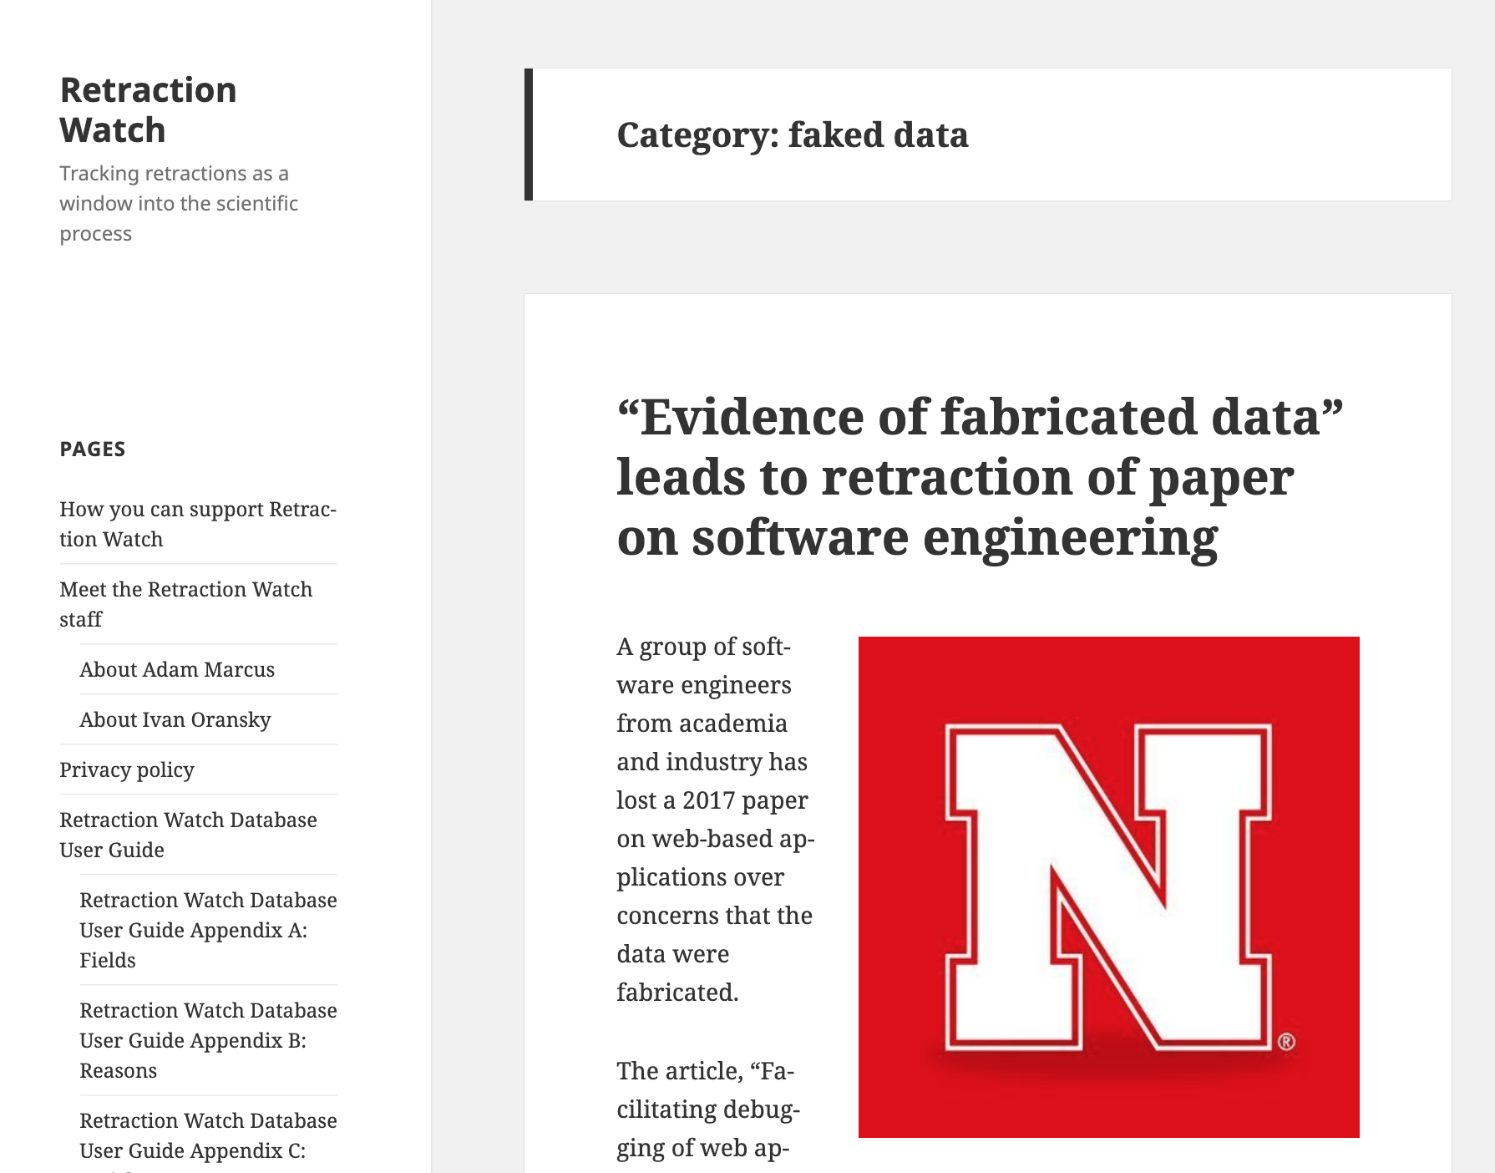
Think Like An Experimentalist
Separate experiment from analysis from communication
Store results of computations
Write separate scripts to analyze results and make plots/tables
Aim for reproducibility!
There are serious consequences for not being careful
Publication retraction
Worse: http://videolectures.net/cancerbioinformatics2010_baggerly_irrh/
Lots of tools available to help, use them! Be proactive: learn about them on your own!

Slide 11
Docker
Docker is a tool for creating containers which allow you to easily distribute and scale code.
Like a VM it abstracts away the actual machine in order to increase portability.
A VM abstracts the hardware, kernel, and user space for every machine.
A container is more lightweight, only the binaries and libraries are are unique for each container.
Both containers and VMs have private space for processing, can execute commands as root, have a private network interface and IP address, allow custom routes and iptable rules, can mount file systems, and etc…
https://www.freecodecamp.org/news/a-beginner-friendly-introduction-to-containers-vms-and-docker-79a9e3e119b/

Slide 12

Docker Land
Where containers go…
To run your…
Web search
Bank account
Product purchase
AI platform
….

Slide 13
Building Docker Files
A Docker container is built out of a Dockerfile
For Project0 we are using the jupyter/datascience-notebook docker image: https://hub.docker.com/r/jupyter/datascience-notebook/dockerfile
List of images: https://hub.docker.com/search/?type=image
A dockerfile contains a line by line what packages should be included in the image to build the container.
A dockerfile can stack on top of other images, for instance, the datascience-notebook is built on top of the jupyter-base notebook.
Once the container is made it volumes are connected back to the host operating system to allow you to read and edit files.

Slide 14
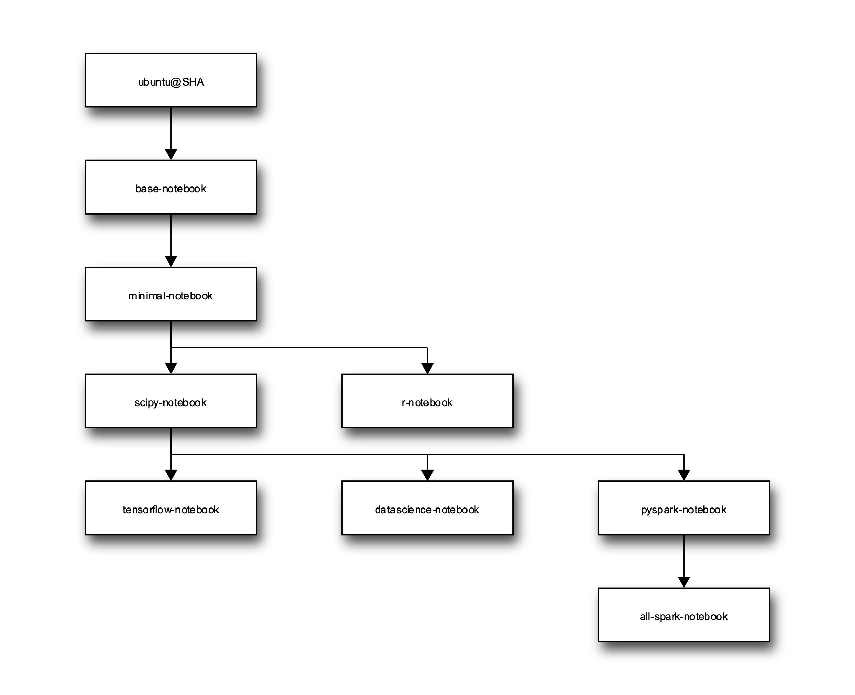
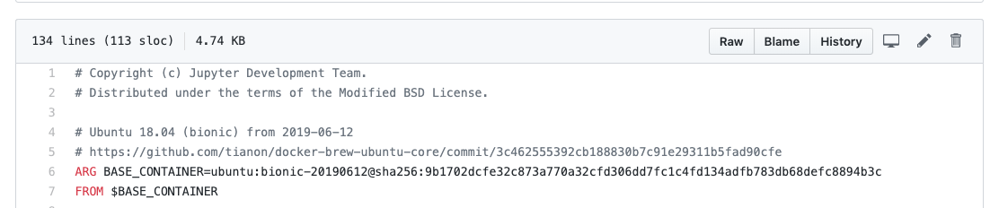
Deep Dive – Jupyter Docker Files
Project Jupyter maintains a set of Docker images for easy use of the notebook and related software.
More about Jupyter Images: https://jupyter-docker-stacks.readthedocs.io/en/latest/using/selecting.html
Looking at the base notebook stack we see it’s built on Ubuntu https://github.com/jupyter/docker-stacks/blob/master/base-notebook/Dockerfile

Slide 15
Unpacking a Docker Command
docker run -it -v /Users/nsmattei/project0:/home/jovyan/notebooks --rm -p 8888:8888 jupyter/datascience-notebook
docker run the command to tell Docker to run a container.
-it Since we are using a program that needs a shell, this tells Docker to give us an interactive terminal
-v /Users/nsmattei/project0:/home/jovyan/notebooks mounts the current project0 directory on the guest OS, so that everything in project0 directory will be available in notebooks directory on the guest.
-rm this tells Docker to clean up after we close the notebook terminal.
-p 8888:8888 maps the 8888 port on the host OS to the 8888 port on the guest container. So if you were to go to http://localhost:8888, it will redirect to the 8888 port on the container - Jupyter Notebook starts a web server on that port on the guest.
jupyter/datascience-notebook tells Docker which container to load.
More details: https://docs.docker.com/engine/reference/run/

Slide 16
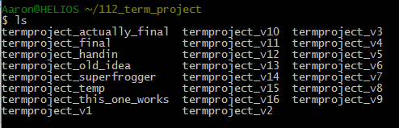
What is Version Control?

Slide 17
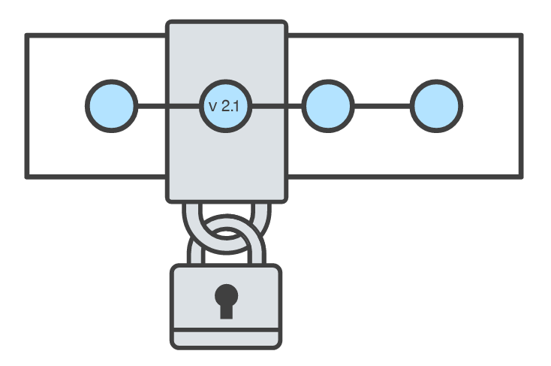
Goals of Version Control
When working with a team, the need for a central repository is essential
Need a system to allow versioning, and a way to acquire the latest edition of the code
A system to track and manage bugs was also needed
Be able to search through revision history and retrieve previous versions of any file in a project
Be able to share changes with collaborators on a project
Be able to confidently make large changes to existing files
atlassian.com/git/tutorials/what-is-version-control

Slide 18
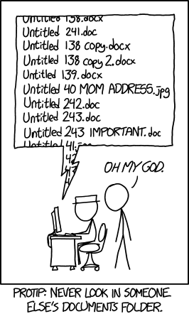
Named Folders Approach
Can be hard to track
Memory-intensive
Can be slow
Hard to share
No record of authorship

Slide 19
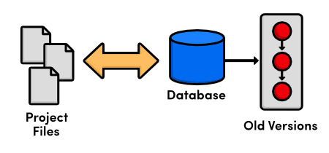
Local Database of Versions Approach
Provides an abstraction over finding the right versions of files and replacing them in the project
Records who changes what, but hard to parse that
Can’t share with collaborators!!

Slide 20
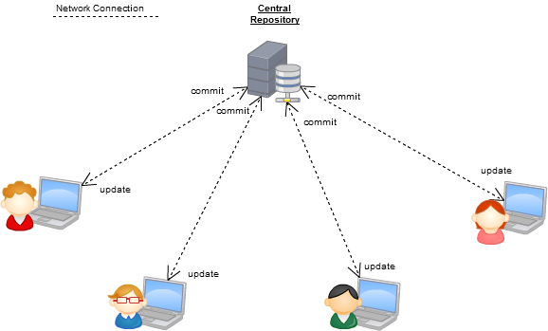
Centralized Version Control Systems
A central, trusted repository determines the order of commits (“versions” of the project)
Collaborators “push” changes (commits) to this repository.
Any new commits must be compatible with the most recent commit. If it isn’t, somebody must “merge” it in.
Examples: SVN, CVS, Perforce

Slide 21
Distributed Version Control Systems (DVCS)
No central repository
Every repository has every commit
Examples: Git, Mercurial
Developer A’s local files
Developer B’s local files
Commit
Dev C’s Repo
Commit
Push/Fetch
Commit
Commit
Dev A’s Repo
Checkout
Central Repository
Checkout
Push/Fetch
Push/Fetch
Push/Fetch
Commit
Commit
Commit
Dev D’s Repo
Developer C’s local files
Checkout
Checkout
Developer D’s local files
Push/Fetch
Dev B’s Repo
Push/Fetch
Centralized Version Control System
Distributed Version Control System
Commit

Slide 22
What is Git
Git is a version control system
Developed as a repository system for both local and remote changes
Allows teammates to work simultaneously on a project
Tracks each commit, allowing for a detailed documentation of the project along every step
Allows for advanced merging and branching operations

Slide 23
A Short History of Git
Linux kernel development
1991-2002.
Changes passed around as archived file – PATCH files.
2002-2005.
Using a DVCS called BitKeeper
2005
Relationship broke down between two communities (BitKeeper licensing issues)
Goals of Git
Speed
Simple design
Strong support for non-linear development (thousands of parallel branches)
Fully distributed – not a requirement, can be centralized
Able to handle large projects like the Linux kernel efficiently (speed and data size)

Slide 24
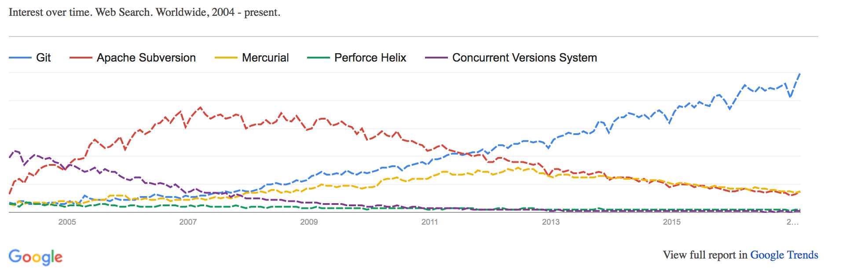
A short history of Git
Popularity:
Git is now the most widely used source code management tool
33.3% of professional software developers use Git (often through GitHub) as their primary source control system
[citation needed]

Slide 25
Git in Industry
Companies and projects currently using Git
Google
Android
Facebook
Microsoft
Netflix
Linux
Ruby on Rails
Gnome
KDE
Eclipse
X.org
IBM

Slide 26
Git Basics
Snapshots, not changes
A picture of what all your files look like at that moment
If a file has not changed, store a reference
Nearly every operation is local
Browsing the history of project
See changes between two versions (diff)

Slide 27
Why Git is Better
Git tracks the content rather than the files
Branches are lightweight, and merging is a simple process
Allows for a more streamlined offline development process
Repositories are smaller in size and are stored in a single .git directory
Allows for advanced staging operations, and the use of stashing when working through troublesome sections

Slide 28
What about SVN?
Subversion has been the most pointless project ever started … Subversion used to say CVS done right: with that slogan there is nowhere you can go. There is no way to do CVS right … If you like using CVS, you should be in some kind of mental institution or somewhere else.
Linus Torvalds

Slide 29
Git vs {CVS, SVN, …}
Why you should care:
Many places use legacy systems that will cause problems in the future – be the change you believe in!
Git is much faster than SVN:
Coded in C, which allows for a great amount of optimization
Accomplishes much of the logic client side, thereby reducing time needed for communication
Developed to work on the Linux kernel, so that large project manipulation is at the forefront of the benchmarks

Slide 30
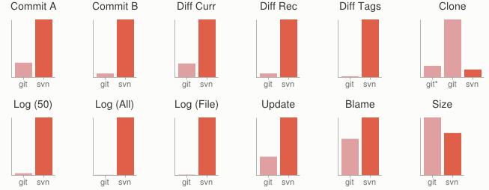
Git vs {CVS, SVN, …}
Speed benchmarks:
Benchmarks performed by http://git-scm.com/about/small-and-fast

Slide 31
Git vs {CVS, SVN, …}
Git is significantly smaller than SVN
All files are contained in a small decentralized .git file
In the case of Mozilla’s projects, a Git repository was 30 times smaller than an identical SVN repository
Entire Linux kernel with 5 years of versioning contained in a single 1 GB .git file
SVN carries two complete copies of each file, while Git maintains a simple and separate 100 bytes of data per file, noting changes and supporting operations
Nice because you can (and do!) store the whole thing locally

Slide 32

Git vs {CVS, SVN, …}
Git is more secure than SVN
All commits are uniquely hashed for both security and indexing purposes
Commits can be authenticated through numerous means
In the case of SSH commits, a key may be provided by both the client and server to guarantee authenticity and prevent against unauthorized access
Git is decentralized:
Each user contains an individual repository and can check commits against itself, allowing for detailed local revisioning
Being decentralized allows for easy replication and deployment
In this case, SVN relies on a single centralized repository and is unusable without a connection to this repository!

Slide 33
Git vs {CVS, SVN, …}
Git is flexible:
Due to it’s decentralized nature, git commits can be stored locally, or committed through HTTP, SSH, FTP, or even by Email
No need for a centralized repository
Developed as a command line utility, which allows a large amount of features to be built and customized on top of it
Data assurance: a checksum is performed on both upload and download to ensure sure that the file hasn’t been corrupted.
Commit IDs are generated upon each commit:
Linked list style of commits
Each commit is linked to the next, so that if something in the history was changed, each following commit will be rebranded to indicate the modification

Slide 34
Git vs {CVS, SVN, …}
Branching
Git allows the usage of advanced branching mechanisms and procedures
Individual divisions of the code can be separated and developed separately within separate branches of the code
Branches can allow for the separation of work between developers, or even for disposable experimentation
Branching is a precursor and a component of the merging process
Merging
The process of merging is directly related to the process of branching
Individual branches may be merged together, solving code conflicts, back into the default or master branch of the project
Merges are usually done automatically, unless a conflict is presented, in which case the user is presented with several options with which to handle the conflict

Slide 35
Git vs {CVS, SVN, …}
Merging – The big differences…
Content of the files is tracked rather than the file itself
This allows for a greater element of tracking and a smarter and more automated process of merging
SVN is unable to accomplish this, and will throw a conflict if, e.g., a file name is changed and differs from the name in the central repository
Git is able to solve this problem with its use of managing a local repository and tracking individual changes to the code

Slide 36
Initialization of a Git repository
C:\> mkdir CoolProject
C:\> cd CoolProject
C:\CoolProject > git init
Initialized empty Git repository in C:/CoolProject/.git
C:\CoolProject > notepad README.txt
C:\CoolProject > git add .
C:\CoolProject > git commit -m 'my first commit'
[master (root-commit) 7106a52] my first commit
1 file changed, 1 insertion(+)
create mode 100644 README.txt
Notes:
After you install git on your machine to get started you will need to initialize a repository.
You can do this by going into your file system, creating a folder and doing git init within the folder.
All the magic happens in the Dot Git folder. This folder IS GIT. You can copy this folder to another machine and it will work.
When I first started playing with git, I had setup a new machine, and was having a hell of a time trying to figure out how I should move my git projects over to the new machine. It was kind of embarrassing. Eventually I just tried to copy it over and it worked.
At this point you really don’t have much. You need to do your first commit to make this light up.
You create a file. When then stage it, but telling git the track this file. In this case I told git to add all files.
Then I was able to commit with a message say this is my first commit.

Slide 37
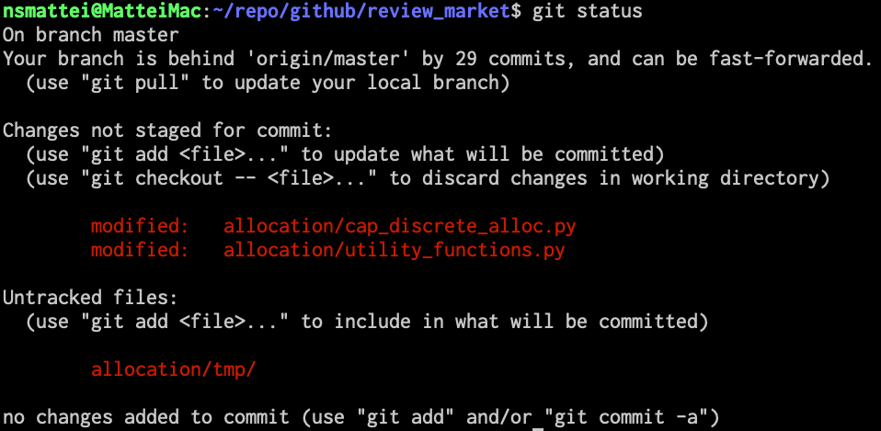
Git Basics I
The three (or four) states of a file:
Modified:
File has changed but not committed
Staged:
Marked to go to next commit snapshot
Committed:
Safely stored in local database
Untracked!
Newly added or removed files

Slide 38
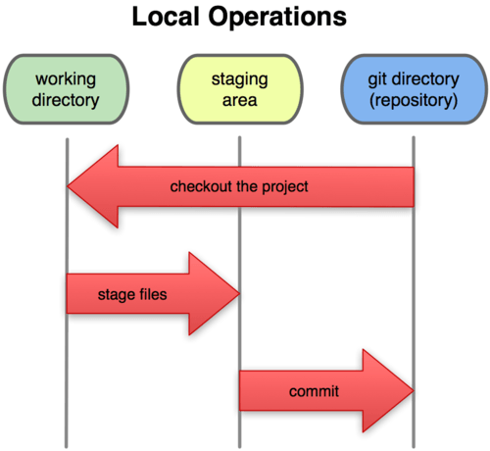
Git Basics II
Three main areas of a git project:
Working directory
Single checkout of one version of the project.
Staging area
Simple file storing information about what will go into your next commit
Git directory
What is copied when cloning a repository

Slide 39
Branches Illustrated
(Default branch is called “master”; your first commit will be on this branch.)
master
A
> git commit –m ‘my first commit’
Notes:
Now lets see what this visually looks like.
On my first commit I have A.
The default branch that gets created with git is a branch names Master.
This is just a default name. As I mentioned before, most everything in git is done by convention. Master does not mean anything special to git.

Slide 40
Branches Illustrated
master
A
B
C
> git commit (x2)
Notes:
We make a set of commits, moving master and our current pointer (*) along

Slide 41
Branches Illustrated
master
A
B
C
bug123
> git checkout –b bug123
Notes:
Suppose we want to work on a bug. We start by creating a local “story branch” for this work.
Notice that the new branch is really just a pointer to the same commit (C) but our current pointer (*) is moved.

Slide 42
Branches Illustrated
master
A
B
C
D
E
bug123
> git commit (x2)
Notes:
Now we make commits and they move along, with the branch and current pointer following along.

Slide 43
Branches Illustrated
master
A
B
C
D
E
bug123
> git checkout master
Notes:
We can “checkout” to go back to the master branch.
This is where I was freaked out the first time I did this. My IDE removed the changes I just made. It can be pretty startling, but don’t worry you didn’t lose anything.

Slide 44
Branches Illustrated
master
A
B
C
D
E
bug123
> git merge bug123
Notes:
And then merge from the story branch, bringing those change histories together.

Slide 45
Branches Illustrated
master
A
B
C
D
E
> git branch -d bug123
Notes:
And since we’re done with the story branch, we can delete it. This all happened locally, without affecting anyone upstream.

Slide 46
Branches Illustrated
master
A
B
C
D
E
F
G
bug456
Notes:
Let’s consider another scenario. Here we created our bug story branch back off of (C). But some changes have happened in master (bug 123 which we just merged) since then.
And we made a couple of commits in bug 456.

Slide 47
Branches Illustrated
master
A
B
C
D
E
F
G
bug456
> git checkout master
Notes:
Again, to merge, we checkout back to master which moves our (*) pointer.

Slide 48
Branches Illustrated
master
A
B
C
D
E
H
F
G
bug456
> git merge bug456
Notes:
And now we merge, connecting the new (H) to both (E) and (G). Note that this merge, especially if there are conflicts, can be unpleasant to perform.

Slide 49
Branches Illustrated
master
A
B
C
D
E
H
F
G
> git branch -d bug456
Notes:
Now we delete the branch pointer.
But notice the structure we have now. This is very non-linear. That will make it challenging to see the changes independently. And it can get very messy over time.

Slide 50
Branches Illustrated
master
A
B
C
D
E
F
G
bug456
Notes:
Rebase flow - Let’s go back in time and look at another approach that git enables. So here we are ready to merge.

Slide 51
Branches Illustrated
master
A
B
C
D
E
F’
G’
bug456
> git rebase master
Notes:
Instead of merging, we “rebase”.
What this means is something like this:
1. Take the changes we had made against (C) and undo them, but remember what they were
2. Re-apply them on (E) instead

Slide 52
Branches Illustrated
master
A
B
C
D
E
F’
G’
bug456
> git checkout master
> git merge bug456
Notes:
Now when we merge them, we get a nice linear flow.
Also, the actual changeset ordering in the repository mirrors what actually happened. (F’) and (G’) come after E rather than in parallel to it. Also, there is one fewer snapshots in the repository.

Slide 53
When to Branch?
General rule of thumb:
Anything in the master branch is always deployable.
Local branching is very lightweight!
New feature? Branch!
Experiment that you won’t ever deploy? Branch!
Good habits:
Name your branch something descriptive (add-like-button, refactor-jobs, create-ai-singularity)
Make your commit messages descriptive, too!

Slide 54
So you want somebody else to host this for you …
Git: general distributed version control system
GitHub / BitBucket / GitLab / …: hosting services for git repositories
In general, GitHub is the most popular:
Lots of big projects (e.g., Python, Bootstrap, Angular, D3, node, Django, Visual Studio)
Lots of ridiculously awesome projects (e.g., https://github.com/maxbbraun/trump2cash)
There are reasons to use the competitors (e.g., private repositories, access control)

Slide 55
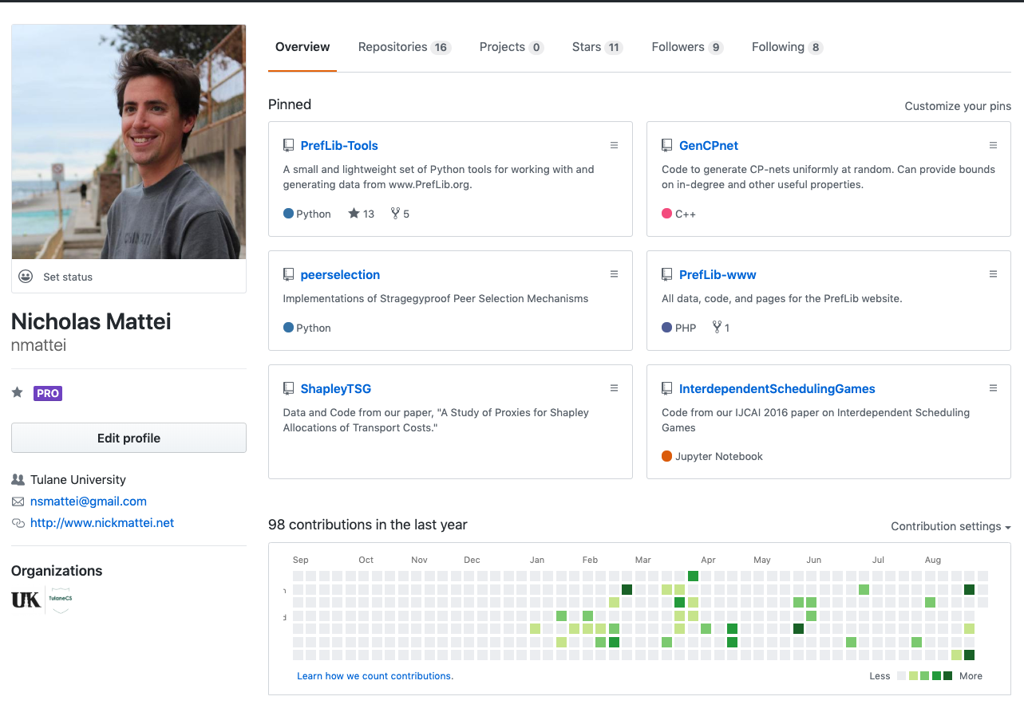
Social Coding

Slide 56
Review: How to Use
Git commands for everyday usage are relatively simple
git pull
Get the latest changes to the code
git add .
Add any newly created files to the repository for tracking
git add –u
Remove any deleted files from tracking and the repository
git commit –m ‘Changes’
Make a version of changes you have made
git push
Deploy the latest changes to the central repository
Make a repo on GitHub and clone it to your machine:
https://guides.github.com/activities/hello-world/
Thanks Avi!

Slide 57
Stuff to click on
Git
http://git-scm.com/
GitHub
https://github.com/
https://guides.github.com/activities/hello-world/
^-- Just do this one. You’ll need it for your tutorial ☺.
GitLab
http://gitlab.org/
Git and SVN Comparison
https://git.wiki.kernel.org/index.php/GitSvnComparison
BitBucket and Sourcetree
https://www.sourcetreeapp.com/

